Slide 1


Slide 2


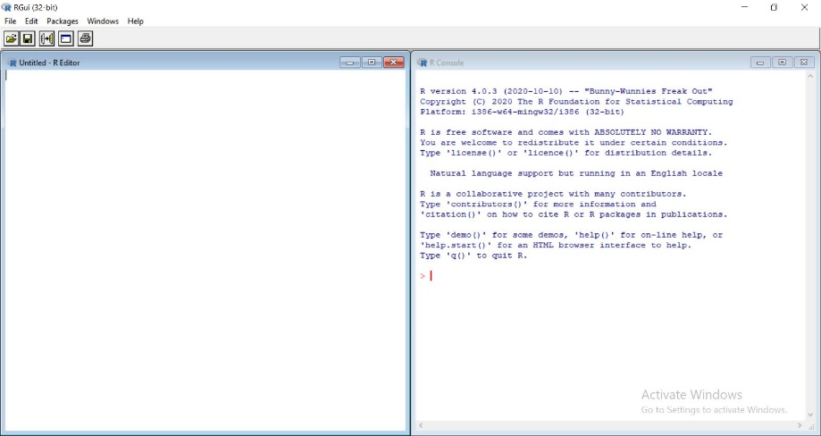
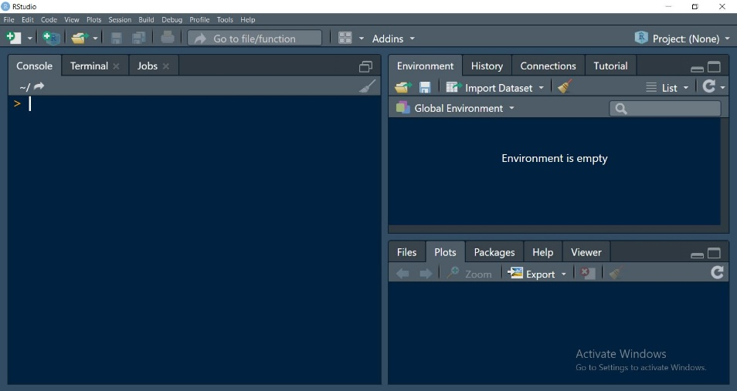

Downloading and Installing the Base R and R studio.
VS
olakunle4impact

Slide 3

Installing the Base R
Since it is a free and an open source software, to download the base R, visit;
https://cran.r-project.org
olakunle4impact

Slide 4
Installing R Studio
R Studio is an Integrated Development Environment (IDE) of R.
It is important to install the base R before installing R Studio
To install R Studio, visit the link below;
https://www.rstudio.com
olakunle4impact

Slide 5
Using R Studio Cloud
This is one beautiful thing about R Studio.
To use this unique online feature, visit the link below;
https://www.rstudio.cloud
olakunle4impact

